Slide 1
PROJECT DESIGN PHASE - II
Project name: Real time communication powered by Ai
for Specially abled person
Team ID :PNT2022TMID32200.

Slide 2
Customer Journey..
Awarness
Consideration
Conversion
Retention
Advocacy

Slide 3
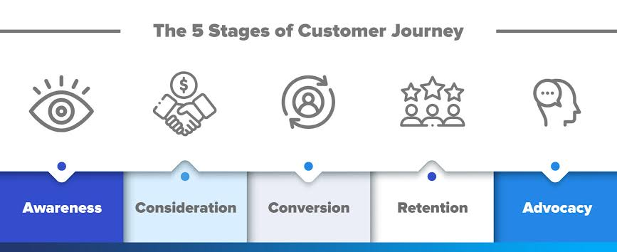
Customer journey map..(way 1)

Slide 4
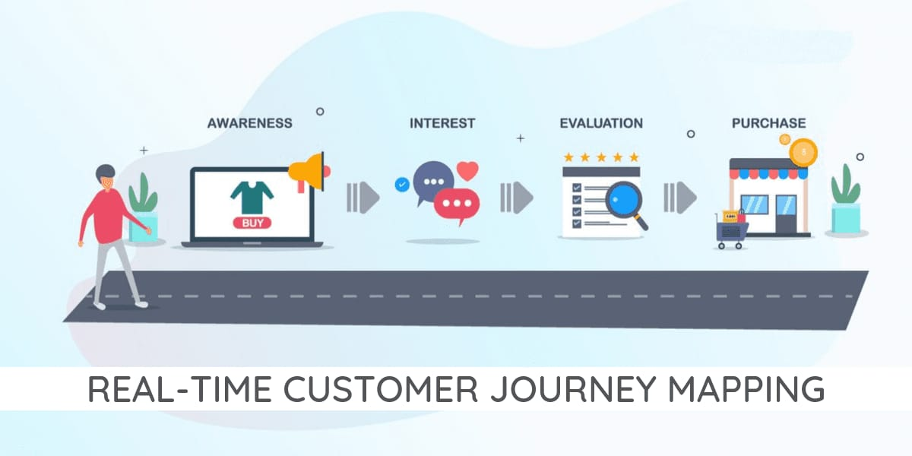
Customer Journey (way 2)

Slide 5
Awarness for realtime communication..
The value of information is determined by the global need for information.
These evaluation methods are adaptive to changing and possibly multiple and multi-dimensional requests and to changing communication constraints for specially abled persons.
These are fulfils the gap of communication.

Slide 6
Consideration for communication.
We have considered all the persons for communication.
We want to communicate the specially abled person for communications.
We have to consider the neural networks for this communication.
We consider the hand and face gestures to get speech output.

Slide 7
Conversion for communication..
Communications between a normal person and with the person having hearing loss and dumb have constantly been a tough assignment.
The work is to develop a portable device for the disabled people those who are not able to communicate with the normal persons properly.
The technology development presents a solution to build up a sign language conversion system to support the individual with hearing loss and mute people

Slide 8
Retention for communication
Stand for something
Collect feed back with customer surveys
Leverages personalization
Deliver surprise reciprocity
Personalize your own way of communication.
Desire higher efficiency of communication.

Slide 9
Advocacy..
On the other hand ,advocacy is a set of targeted
Actions directed at decision-makers in support of a specific policy issue
To desire and recognize the hand gestures to the easily understandable speech languages.

Slide 10
THANK YOU…
AAKASH K (TEAM LEAD)
JEEVADHARSHINI V (MEMBER)
JAYACHANDRAN M S (MEMBER)
MONISHAN J (MEMBER)

